Slide 1

Large Language Models in Reinforcement Learning – A Comparison of Methods
Authored by: Jonatan Hoffmann Hanssen, Gregor Kajda, Adrian Duric
Supervisors: Katrine Nergård, Kai Olav Ellefsen

Slide 2
Introduction: The challenges of Learning in Complex Environments

Slide 3
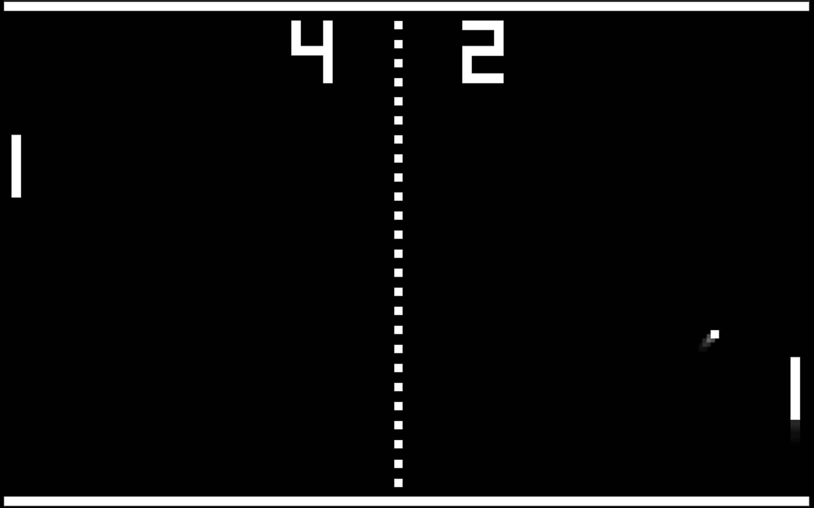

Learning in Complex Environments
Large state and action spaces
Hard for agent to reach goals – sparse rewards
Human intuition helps, and Large Language Models (LLMs) have this intuition built-in
Can intuition be integrated in Reinforcement Learning (RL)?
We examine how to do so, using LLMs
Pong: a simple environment with few states and only three actions.
Elden Ring: large, complex environment where reaching the goal takes 60 hours even for a human.

Slide 4
Background: A short Recap

Slide 5

LLMs as Policy in RL
LLM receives state observation, and is asked to suggest action
LLM influences probabilities of each action
Alongside actor in Actor-Critic Network
LLM-proposed actions get increased probabilities, others are lowered
Source literature:
Zhang et al., 2023
Li et al., 2022
Some environments may require very specific actions to be chosen at some timestep, such as with self-driving cars on the road.

Slide 6

LLMs as Reward in RL
LLM receives state observation, and is asked to suggest action
Agent acts independently; performed actions are captioned in natural text
Reward is given if agent acts similarly to suggested action
Independent of reward function in Actor-Critic
Source literature: Du et al., 2023
Candy is only given to agents who behave semantically similarly!

Slide 7
Methods

Slide 8

Our approach
Compare three different methods of integrating an LLM with PPO
Reward shaping
Direct policy influencing
Both at the same time
We compare all these to baseline PPO

Slide 9

LLM integration details
How can an LLM interact with a non-textual world?
World and actions must be described in text
Hard-coded captioners
LLM gives textual answer to prompt
Action and answer can be compared semantically using encoding and cosine similarity
Left: PPO. Center: High semantic similarity. Right: LLM.

Slide 10

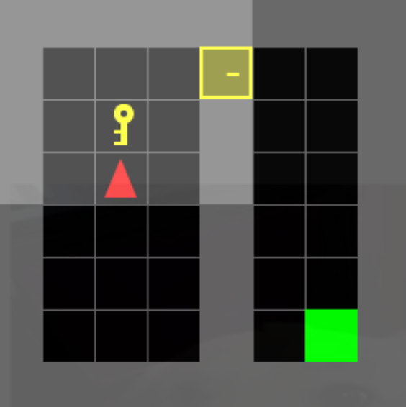
Pipeline
LLM
State
"I see a yellow key directly in front, see a yellow door right and forward"
"You should pick up the yellow key"
State captioner
Semantic similarity: 93%
PPO
Action captioner
Move forward: 15%
Turn right: 20%
Turn left: 15%
Pick up: 50%
"Pick up yellow key"

Slide 11
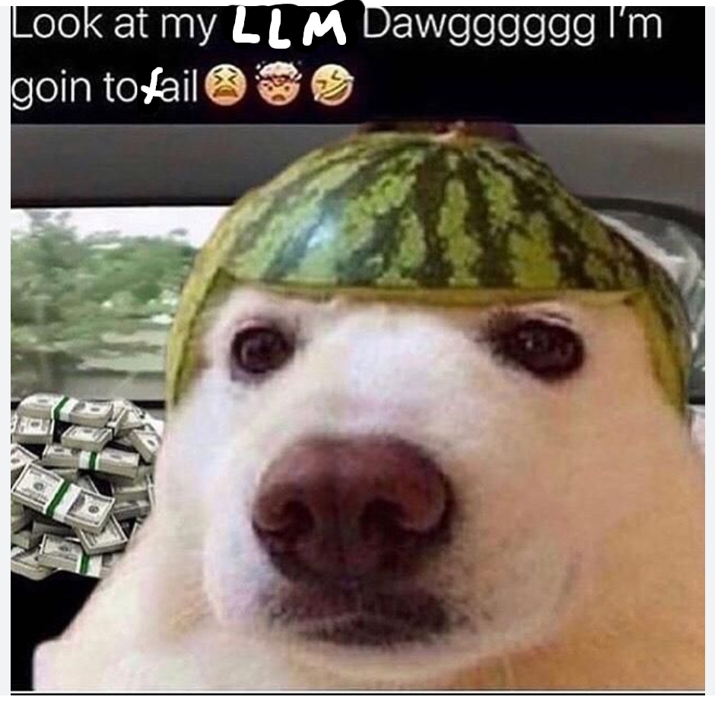
Llama 2: our llm of "choice"
An open source LLM that we can run locally
Llama 2 offers a great price to performance ratio of
Bad performance
For 0 dollar (infinite ratio!)
This leads to some problems in more complicated environments, but in general it is good enough

Slide 12

Our Policy influencing method
Semantic similarity is compared to all possible actions given the state
Semantic sim. is added directly to logits from Actor in PPO, influencing action probabilities
Policy Influencing gives more direct instructions, like an Oscar award-winning coach gives to a player.

Slide 13

Our Reward shaping method
Following Du et Al.
Same as can be seen in the pipeline slide
Compared to policy influencing, this is less direct as it affects action probabilities only through backpropagation after the episode is completed
Reward shaping gives more indirect advice, like an advisor gives in a stock photo.

Slide 14

Combination
Use both direct policy influencing and indirect reward shaping
Idea:
Policy influencing gives short term direct instructions
Reward shaping affects performance long term

Slide 15
Experiments
Details about Environments

Slide 16
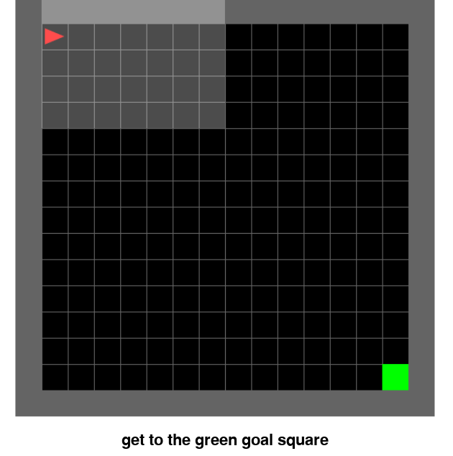
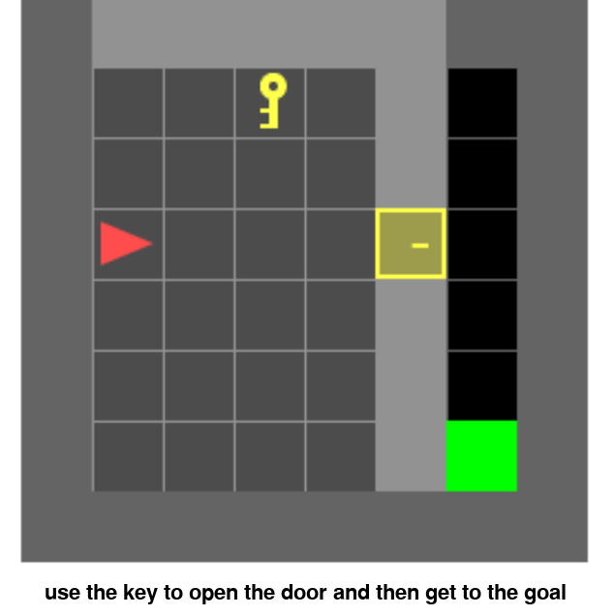
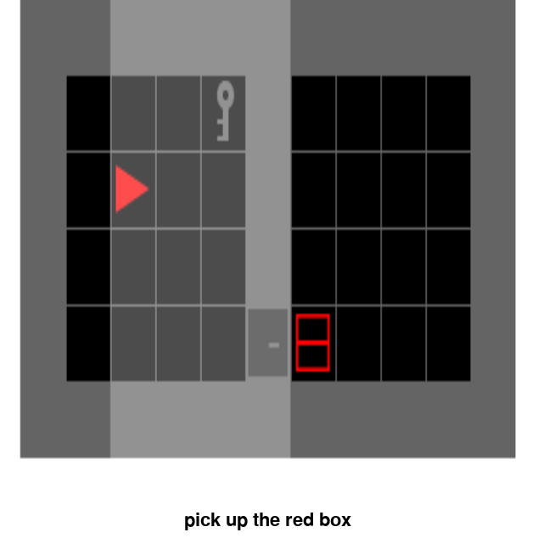
Minigrid Environments
Simple, grid-based environments
Sparse rewards
Varying degrees of complexity:
Simple: Empty (top left)
Medium: DoorKey (top right)
Complex: UnlockPickup (bottom)
"In the doorkey environment, doors guard passages, concealing the way forward like guardians of a secret. The catch? These doors yield only to the touch of a specific key." - ChatGPT

Slide 17
Does it work?
Results

Slide 18
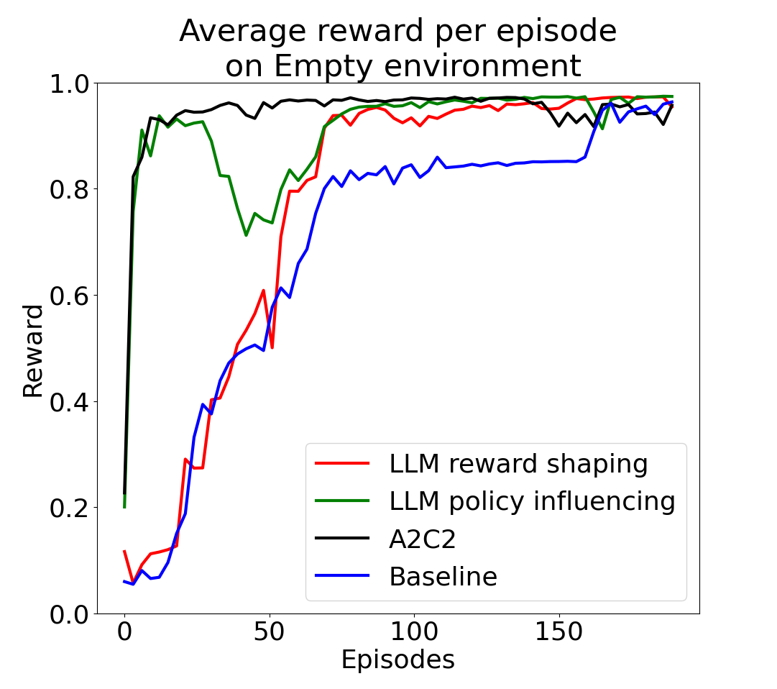
Empty environment
It does work!
All LLM methods outperform baseline
Policy shaping and A2C2 performs best
Simple environment means direct recommendations perform best
A2C2 outperforms baseline by 37%

Slide 19
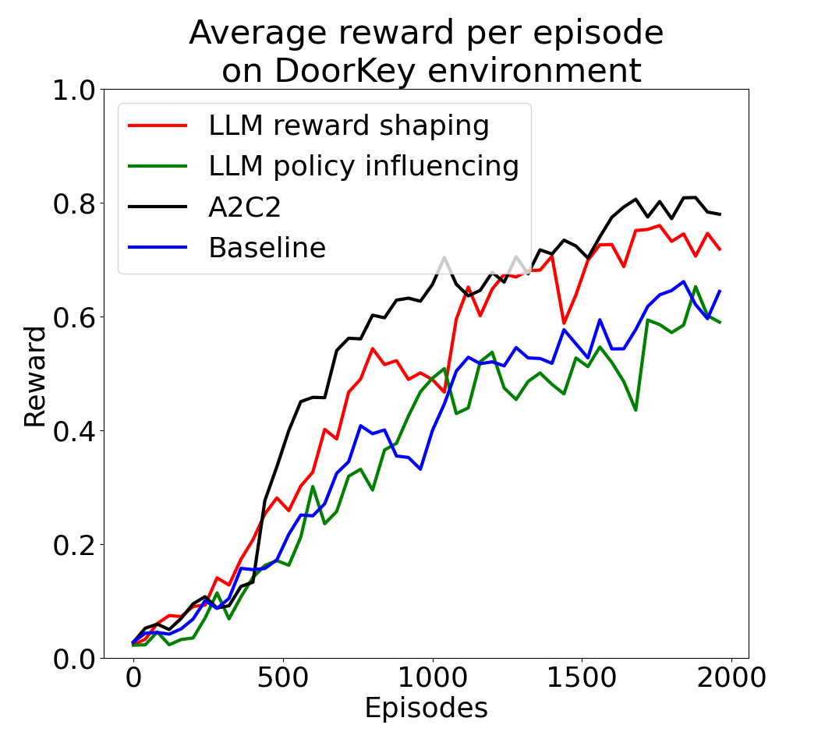
Doorkey environment
LLM integration still very beneficial
A2C2 outperforms baseline by 38%
Policy influencing on its own struggles, probably because of the more complicated environment

Slide 20
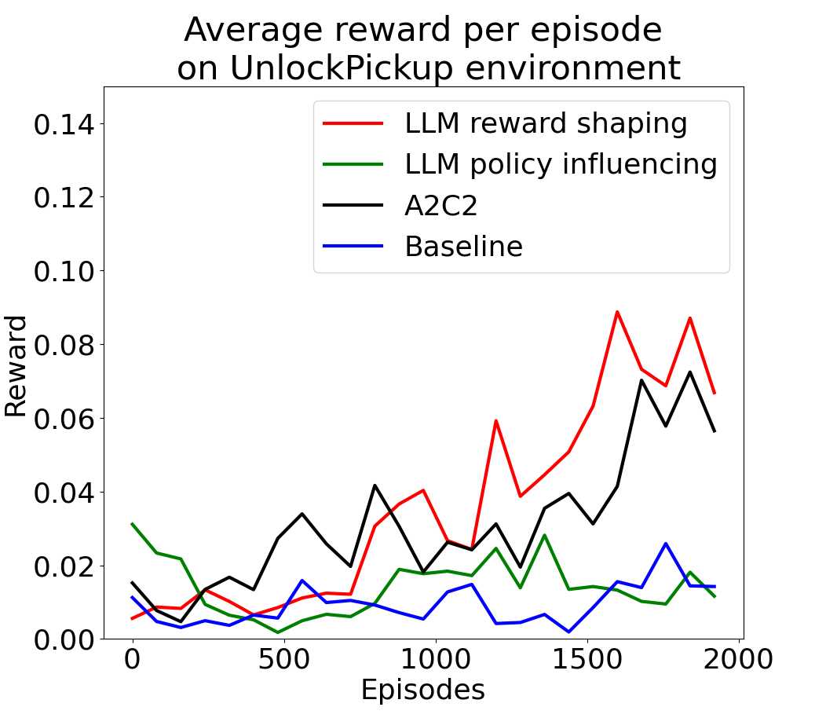
Unlockpickup environment
Very difficult for all methods
No method reaches over 0.10 in average reward
A2C2 and reward shaping perform best, policy struggles
Direct recommendations are not as beneficial in difficult environments where the recommendations may not be as good

Slide 21
Ethics
All considerations regarding LLMs are added to the RL framework
LLM is stochastic – it could add its own noise to the agent
LLM is biased – it could propose biased and/or unfair behavior
When used in real environments, this must be tested
Explainable AI is a step forward here!

Slide 22
Conclusion
LLM integration is beneficial in many cases
Combination of reward shaping and policy influencing is beneficial in many cases
Policy influencing struggles in more complicated environments
Further work
Finetune Llama 2
Use a better LLM
Make policy influencing contribute to logits in a more consistent manner
Perform hyperparameter search

